Slide 1
Nuclear physics activities at INRNE, BAS
Assoc. prof. Petko B. Krastev
ECFA – Sofia, 2025

Slide 2
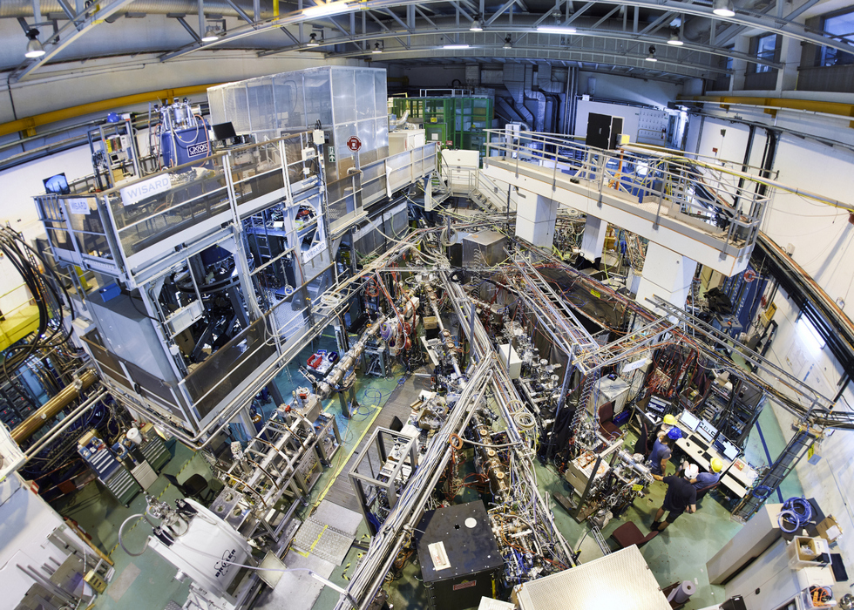
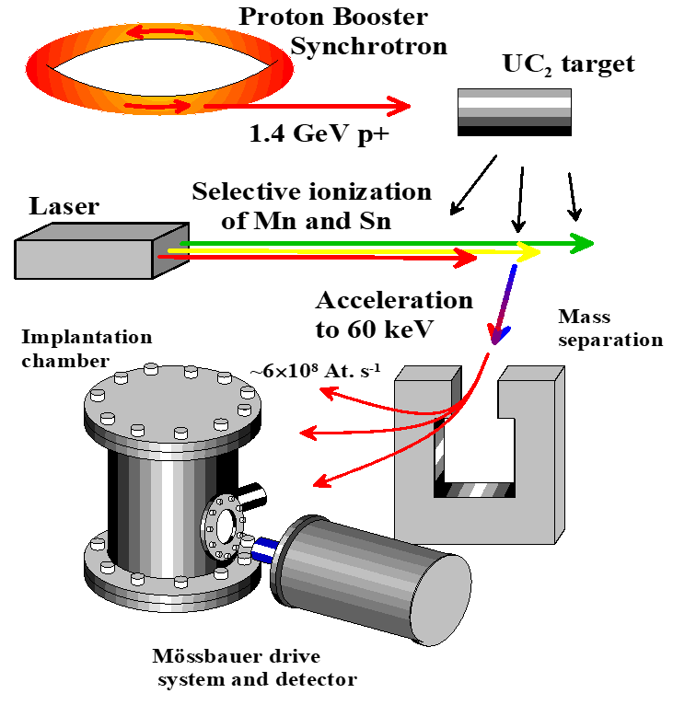
Emission Mössbauer spectroscopy (eMS) at ISOLDE, CERN

Slide 3
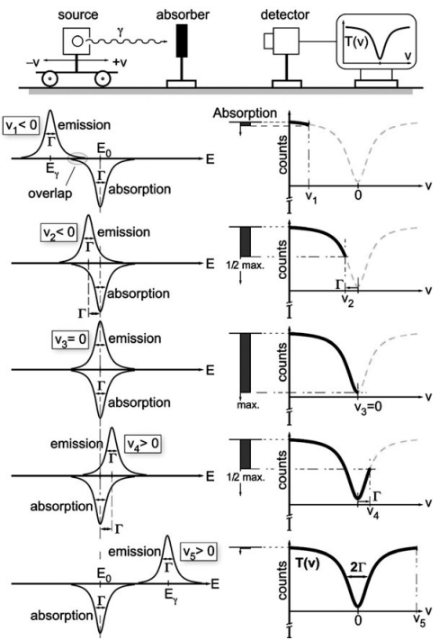
Mössbauer spectroscopy preview
Mössbauer effect is, the recoilless emission and the recoilless resonant absorption of γ photons by the nucleus.
Mössbauer spectroscopy is a spectroscopic technique based on the Mössbauer effect.
Notes:
Recovering of the spectra

Slide 4
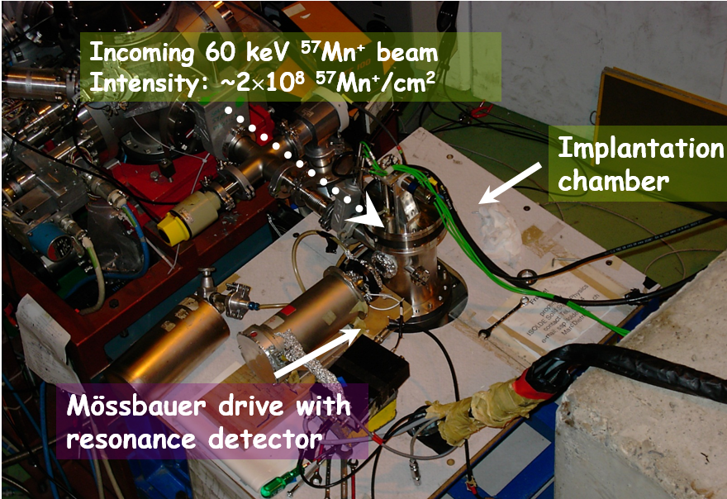
Experimental setup eMS setup
Implantation of ⁵⁷Mn (T_{½} = 1.5 min) and ⁵⁷Co (T_{½} = 272 d) at ISOLDE/CERN for ⁵⁷Fe emission Mössbauer spectroscopy
is possible to study very low concentration of implanted atoms (10⁻⁵ at.%).

Slide 5
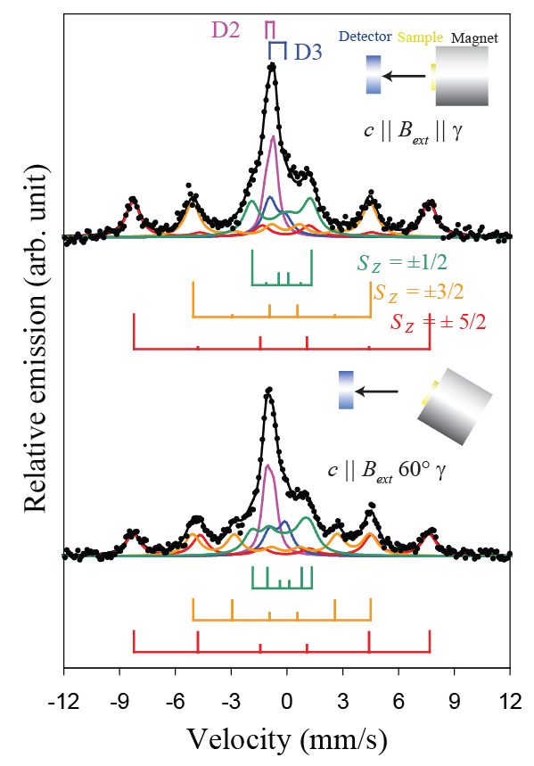
Information from hyperfine interactions parameters

Slide 6
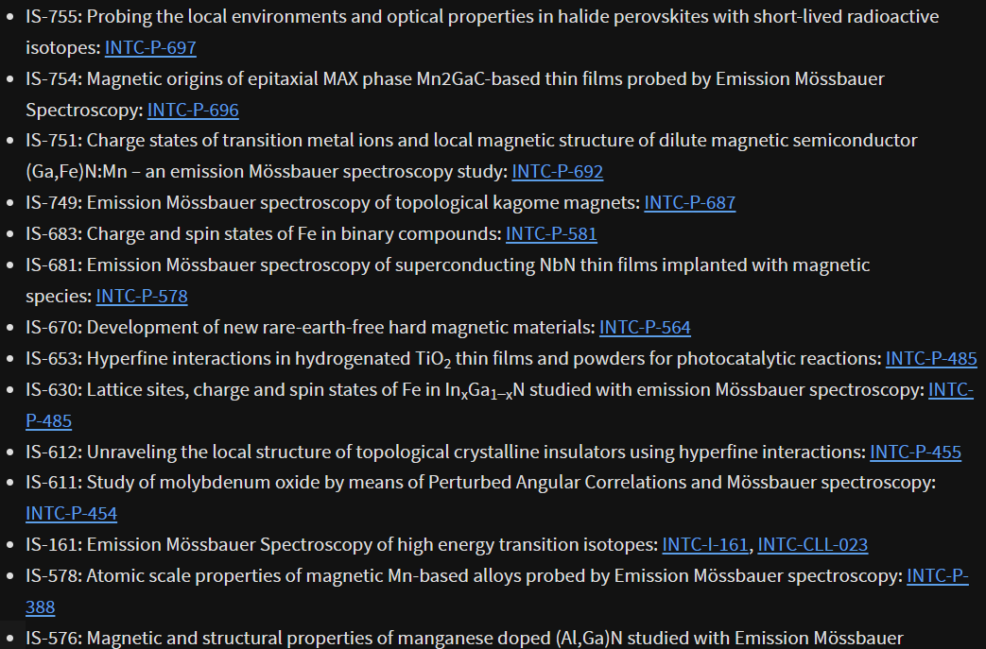
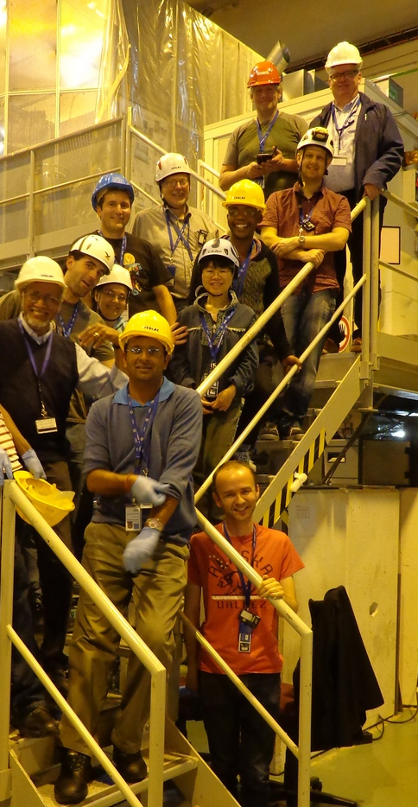
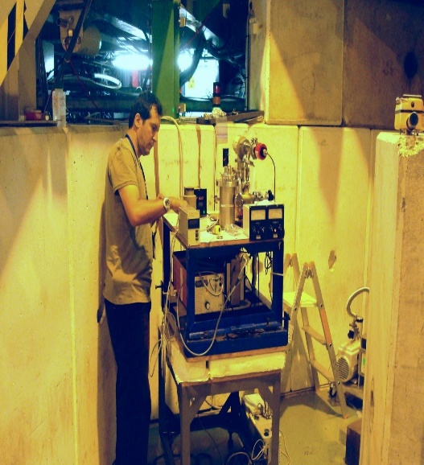
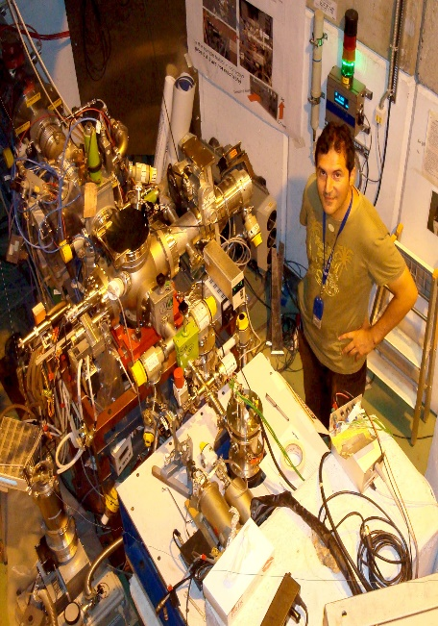
Emission Mössbauer spectroscopy international group
In 1996-1998, the modern facility for Mössbauer research at the ISOLDE complex was built, under the leadership of G. Weyer and H. Gunnlaugsson from Aarhus University, Denmark.
The international eMS group is actively involved in the activities of ISOLDE, with more than 13 active experimental themes currently underway.

Slide 7
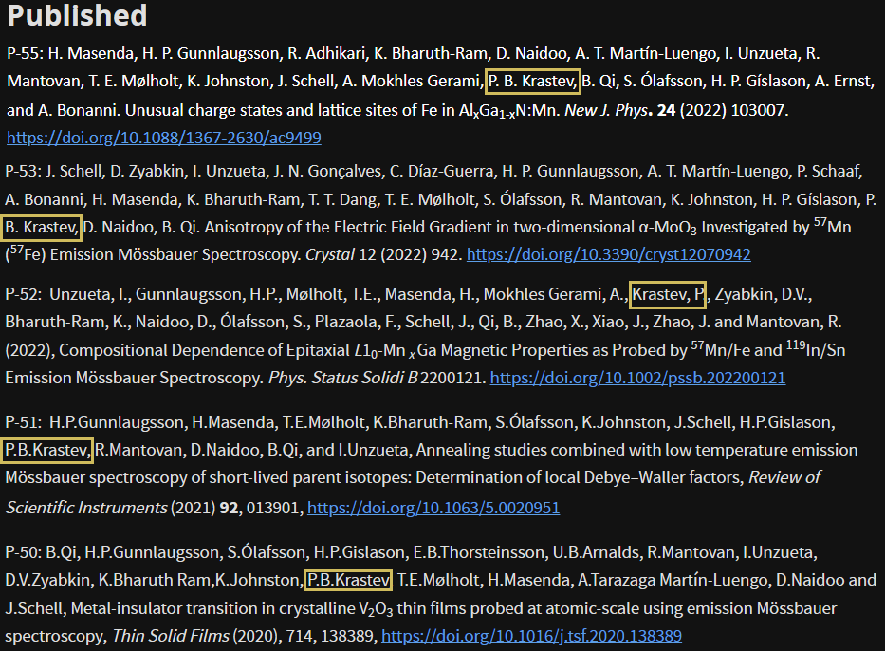
https://e-ms.web.cern.ch
International participation has expanded over the years, with the group numbering around 30 scientists from prestigious universities in Europe, Asia and Africa.
Experimental fields :
Dilute magnetic semiconductors: {GaAs}, {TiO₂}, {GaSb}.
Study of new materials: {TiN}, {V₂O₃} and thin films {ZnO}, {In₂O₃}.
Comparison between experimental and theoretical data regarding phase composition, spin states and changes in the crystal compound structure: {Al₂Ga₃}, {NaCl}, {LiF}, {TiO₂}.
Modification of materials containing rare earth metal oxides.
Studying the influence of impurity ions in various compounds, such as {SiGa}, {NbN}, {GaN}.
Topological kagome magnets: Fe₃Sn₂.

Slide 8
eMS setup updates

Slide 9
Development prospects
There is no funding specifically for the INRNE to visit ISOLDE and we rely on our colleagues from Sofia University.
We are eager to continue and expand the cooperation between INRNE and ISOLDE to other experimental facilities besides eMS, as well as participation in joint projects for exchange of regarding doctoral and postdoctoral students.
Number of scientists participating in eMS: two: Prof. D. Tonev supervisor and P. Krastev.
Particular topic for the study: Investigation of rare earth garnet oxides.

Slide 10
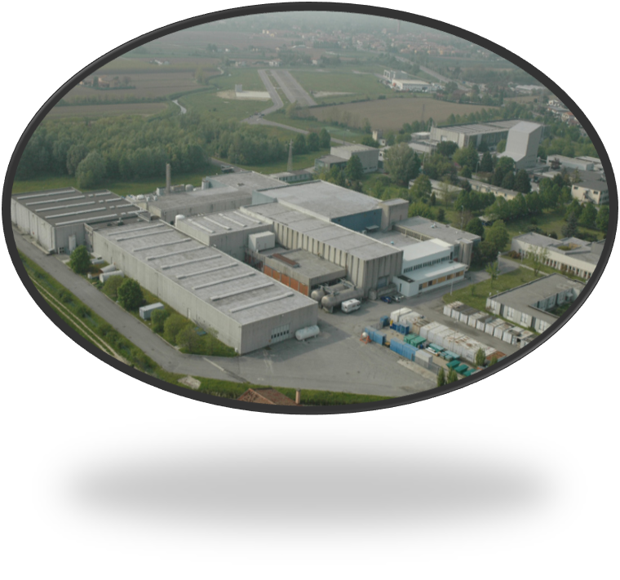
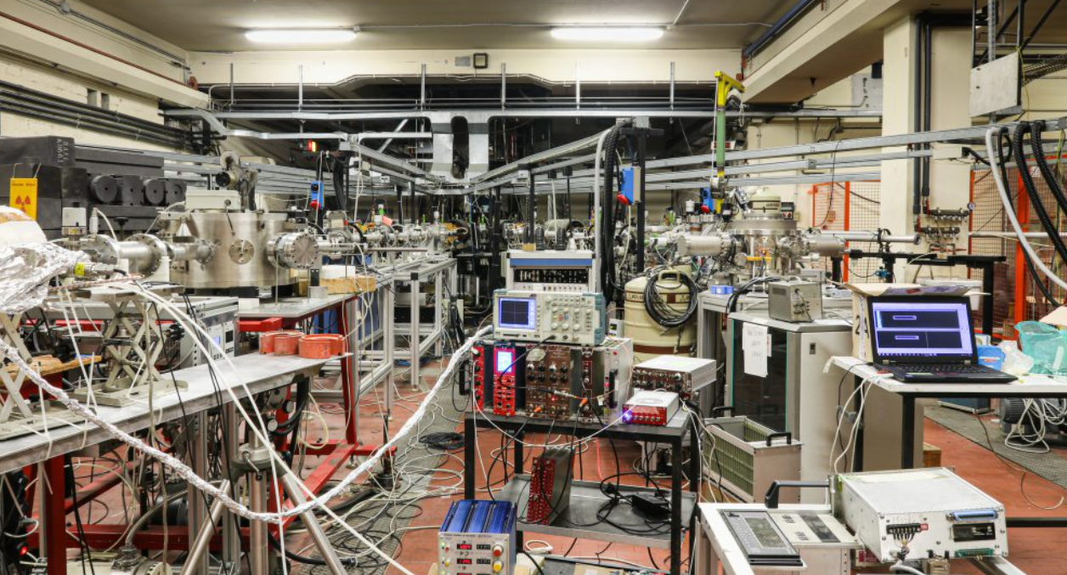
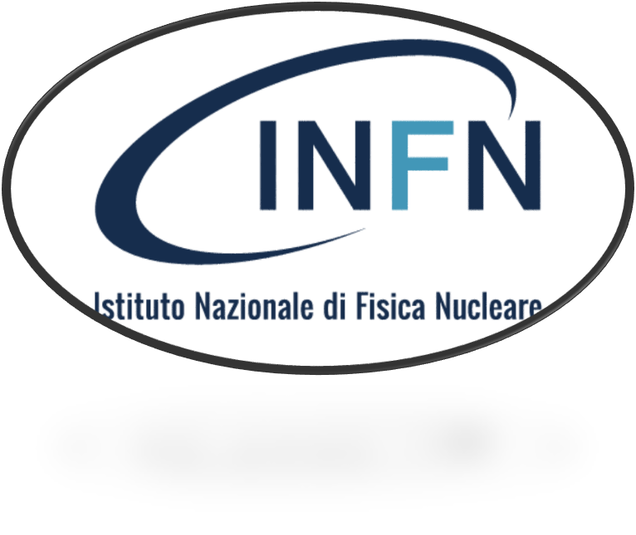
Studying the structure of light nuclei in the mass region A=30.
Experiment: Measurings of lifetimes at the National Laboratory in Legnaro: Italian National Institute for Nuclear Physics, with the PIAVE-ALPI accelerator complex and the GASP gamma-ray spectrometer.

Slide 11
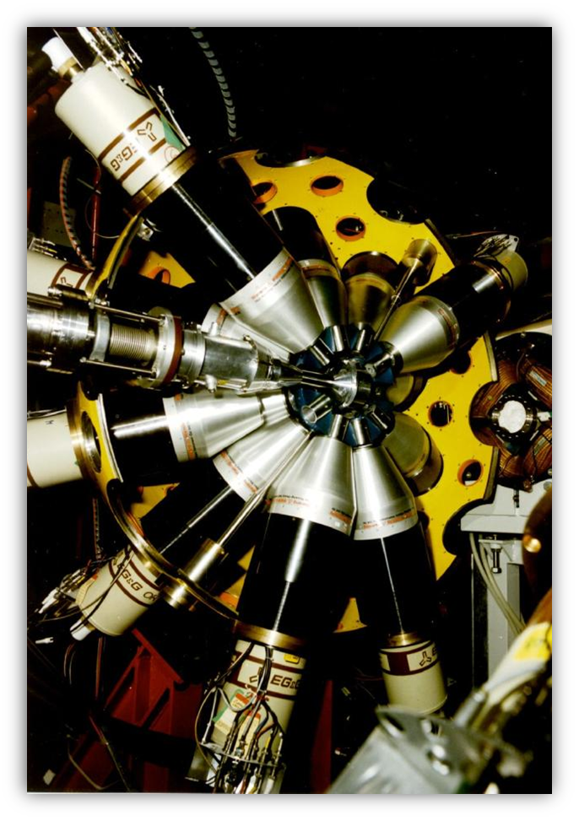
PIAVE-ALPI Setup
The complex consists of:
PIAVE injector and an ALPI linear accelerator
Ion source
High voltage terminal "Stripper" composed of multiple foils
Magnetic systems directing the beam to the target
40 high-performance detectors made of ultrapure germanium (HPGe) with anti-Compton protection
4π calorimeter composed of 80 BGO crystals arranged in seven circles, at different angles to the beam: 34°(6 pieces), 59°(6), 72°(4), 90°(8), 108°(4), 121°(6) and 146°(6).
Participants in the project two:
Yvaylo Panteleev PhD student
and Prof. D. Tonev supervisor.

Slide 12
Nuclear Physics experiments at the 9-MV FN Pelletron Tandem accelerator at IFIN-HH Magurelle, Romania.
Two researchers from the Institute of Nuclear Research and Nuclear Energy, Bulgarian Academy of Sciences perform Nuclear Physics experiments at the 9-MV FN Pelletron Tandem accelerator at IFIN-HH Magurelle, Romania. The Nuclear Structure experiments are performed at the ROSPHERE multi-detector array, which consists of 25 high-purity germanium detectors with anti-Compton shields
or alternatively the setup can accommodate up to 15 LaBr3:Ce fast scintillators for fast-timing measurements of lifetimes of nuclear states. Experiments for life-time measurements using plunger chamber can also be performed.
The experiment regards measuring the “Lifetimes of the Ag core-excited states”. The results were published in 2024 in Physics Scripta under the title “Core-excited states in ¹⁰⁵Cd”.
Elena Stefanova also has two accepted experiment proposalsfor 2025 .
The physicists are speaker and co-speaker to one of the experiments, which aims to measure the “Lifetimes of Octupole states in ⁸⁹Sr and ⁹⁰Sr”. Enhanced octupole correlations are expected for the states of interest.

Slide 13
INTERNATIONAL NETWORK OF NUCLEAR STRUCTURE AND DECAY DATA EVALUATORS (NSDD)
Orlin Iordanov (INRNE) from the Experimental Physics group is working on behalt of the INTERNATIONAL NETWORK OF NUCLEAR STRUCTURE AND DECAY DATA EVALUATORS (NSDD) within the APRENDE project.
The project aims the evaluation of nuclear data and preparation for their inclusion into the Evaluated Nuclear Structure Data File (ENSDF), maintained by the National Nuclear Data Center, Brookhaven National Laboratory.
The activity is performed together with the Faculty of Physics of the St. Kliment Ohridski University, within a broad international collaboration including leading research facilties in the field.

