Slide 1
Elementary Particle Theory at the Bulgarian Academy of Sciences and Sofia University
Lilia Anguelova
Institute for Nuclear Research and Nuclear Energy
Bulgarian Academy of Sciences

Slide 2
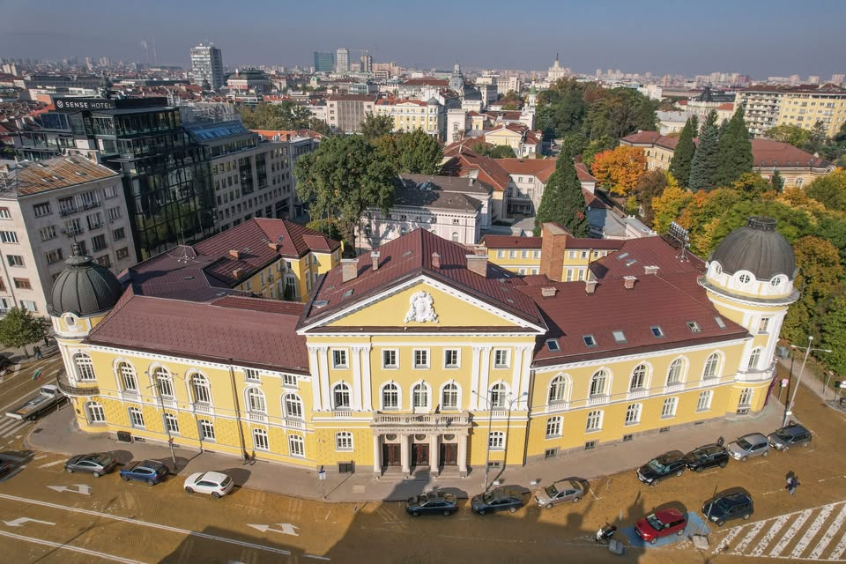
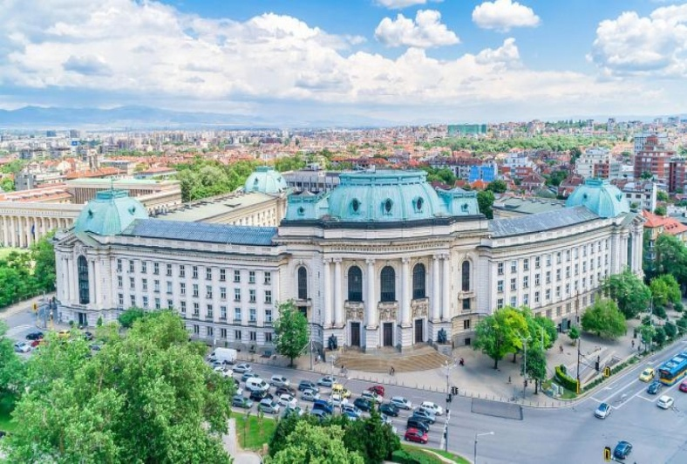
Two main centers of particle physics:
Institute for Nuclear Research and Nuclear Energy (INRNE) at the Bulgarian Academy of Sciences (BAS)
Physics Department at Sofia University “St. Kliment Ohridski”

Slide 3
Theory at INRNE - BAS
Four theoretical groups (called “Laboratories”):
“Theory of Elementary Particles”
“Mathematical Modeling in Physics”
“Theory of Atomic Nuclei”
“Quantum informatics”
At present, there is a lot of overlap between the research conducted by these theory groups.

Slide 4
Lab. “Theory of elementary particles” (15 researchers)
Research topics:
Quantum field theory
General relativity, modified theories of gravity
Early Universe cosmology, dynamical dark energy
String theory and holographic correspondence
Conformal (super)symmetry, Lie (super-)algebras
Quantum groups, generalized quantum statistics

Slide 5
Lab. “Mathematical modeling in physics” (11 researchers)
Research topics:
Theoretical high energy physics including phenomenology
Physics of multiparticle quantum systems
Quantum informatics
General relativity and cosmology
Methods of mathematical modeling

Slide 6
Lab. “Theory of atomic nuclei” (9 researchers)
Research topics:
Nuclear structure and nuclear reactions
Nucleon correlations in atomic nuclei
Nucleon density and momentum distributions
Algebraic and geometric models of the nucleus
Nuclear shapes and symmetries, superscaling
Lepton scattering on nuclei, exotic nuclei

Slide 7
Lab. “Quantum informatics” (4 researchers)
Research topics:
Quantum information and quantum communication
Quantum cryptography
Quantum computers
Quantum communication protocols, systems and networks
Quantum entanglement

Slide 8
Main BG sources of funding
State-approved budget of BAS:
Basically, this covers only the salaries.
National Science Fund grants:
This is the only source of travel funding for many
researchers in the Academy, including at INRNE.
Hence: funding problems…

Slide 9
Funding problems
Availability of funds:
Not everyone, and not always, has a grant.
Travel funds are a limited (insufficient) percentage
of the grant amount. [ Ex.: 2500 EUR / person per year and a half ]
Bureaucratic complexities:
Typical grants for fundamental research have an
interruption in the middle of their duration.
More precisely, they have 2 stages, each only 18 months
long, and require a midterm scientific and financial
activities report and its evaluation by the BNSF, after
the 1st stage.

Slide 10
No funding for postdocs
State-approved budget of BAS:
Does not provide funding for standard postdoc positions.
National Science Fund grants:
Provide some limited amount for (a one-time or two-time)
payment to postdocs or graduate students, which is highly
insufficient for a reasonable monthly salary/stipend.
The postdoc system is not developed/is not existent
in Bulgaria.

Slide 11
International funding
Participation (Lab. TEP) in COST Actions:
COST Action CA22113 “Fundamental challenges in theoretical physics”
COST Action CA21136 “Addressing observational tensions in cosmology with systematics and fundamental physics”
COST Action CA21109 “Cartan geometry, Lie, integrable systems, quantum group theories for applications”
COST Action CA21106 “Cosmic WISPers in the Dark Universe: Theory, astrophysics and experiments”

Slide 12
Other international funding sources
SEENET-MTP:
(Southeastern European Network in Mathematical and Theoretical Physics)
Limited funding for regional events or scientific visits
IRN-QFT:
(International Research Network on Quantum Fields and Strings)
Mostly European scientific centers, but also a handful of US and Asian ones: limited funding for short scientific visits to those centers;
Aimed at junior researchers (advanced PhD students and postdocs)

Slide 13
Theory at Physics Dept. of SU (15 researchers)
Тheoretical high-energy groups:
“String Theory and High Energies”
“Gravitation, Cosmology and Relativistic Astrophysics”
“Quantum Informatics”
“Quantum multi-particle dynamics”
Many common interests with the theorists at INRNE. Should try to foster collaborations between the two institutions…

Slide 14
Funding situation at SU
Same as BAS:
State-approved budget:
Covers only the salaries
National Science Fund grants:
Same issues as described on previous slides
International funding:
Participation in European COST Actions
Additional source of funding:
SUMMIT grant:
Funding from the Bulgarian Recovery and Resilience Plan

