Slide 1

Bachelor thesis defense:
Construction and study of a Compton camera for gamma ray measurements
Author: Galin Bistrev
Faculty number: 2PH076003

Slide 2
Outline
Interaction of gamma rays with matter
  Basic Kinematics
  Cross section
Detectors for gamma rays
  Energy measurement
  Direction measurement
Basic principles of Compton camera
  Designs and applications
Study of prototypes towards the construction of a Compton camera
  Design
  Results
Conclusions

Slide 3

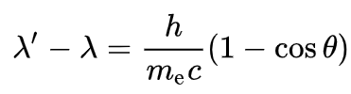

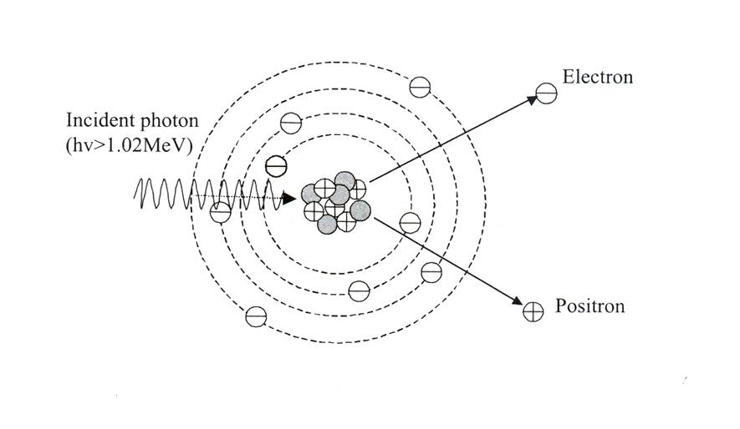
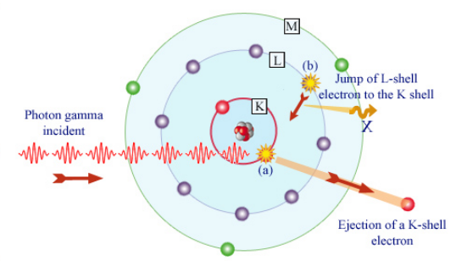
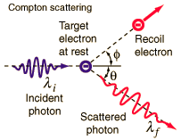
Interaction of gamma rays with matter – Basic kinematics
Three main interaction mechanisms:
Photoelectric effect
Compton scattering
Pair production

Slide 4
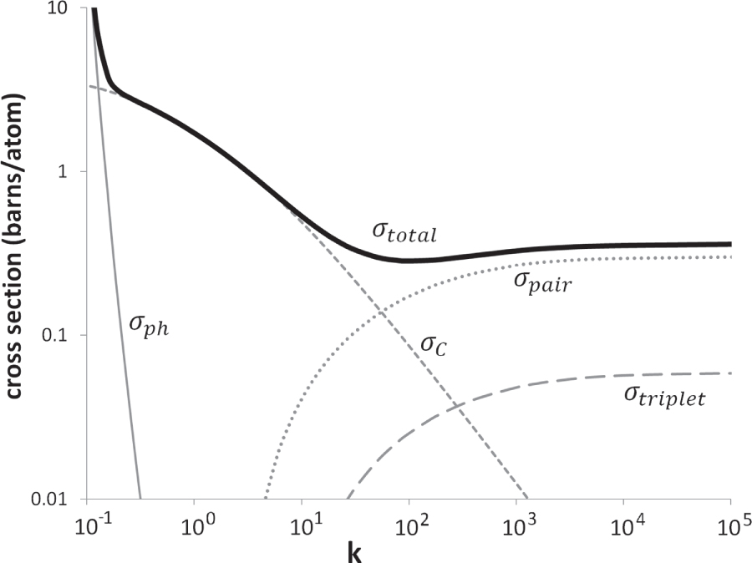

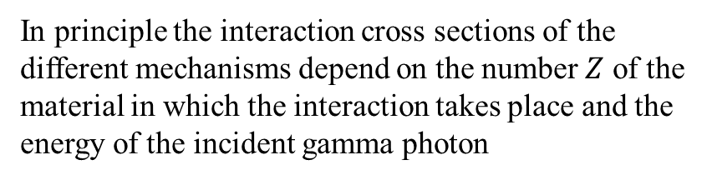
Interaction of gamma rays with matter – Cross sections
In principle the interaction cross sections of the different mechanisms depend on the number $Z$ of the material in which the interaction takes place and the energy of the incident gamma photon
There are many different expressions for the cross sections of the different interactions. Each of them is valid only for a specific energy range
$$k=\frac{E_{γ}}{E_{e}}$$

Slide 5

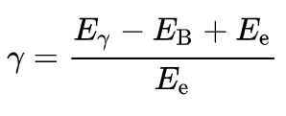

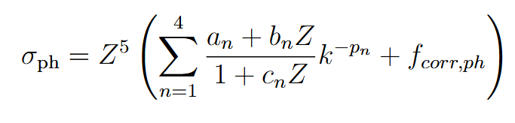





Example
For $E_{γ}≤0.5 MeV$
$E_{B}$-binding energy of the electron
Thompson cross section
For $E_{γ}≥0.5 MeV$
$a_{n},b_{n},p_{n},c_{n}$ - parameters of the empirical fit
$f_{corr,ph}−correction factor$ for higher precision

Slide 6
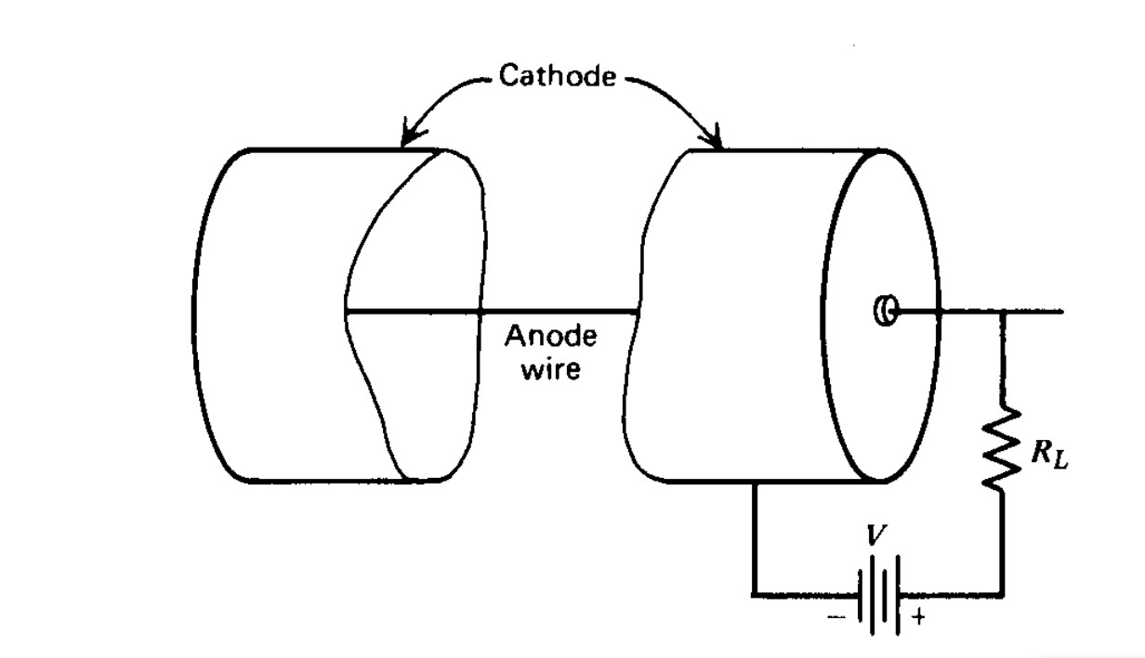
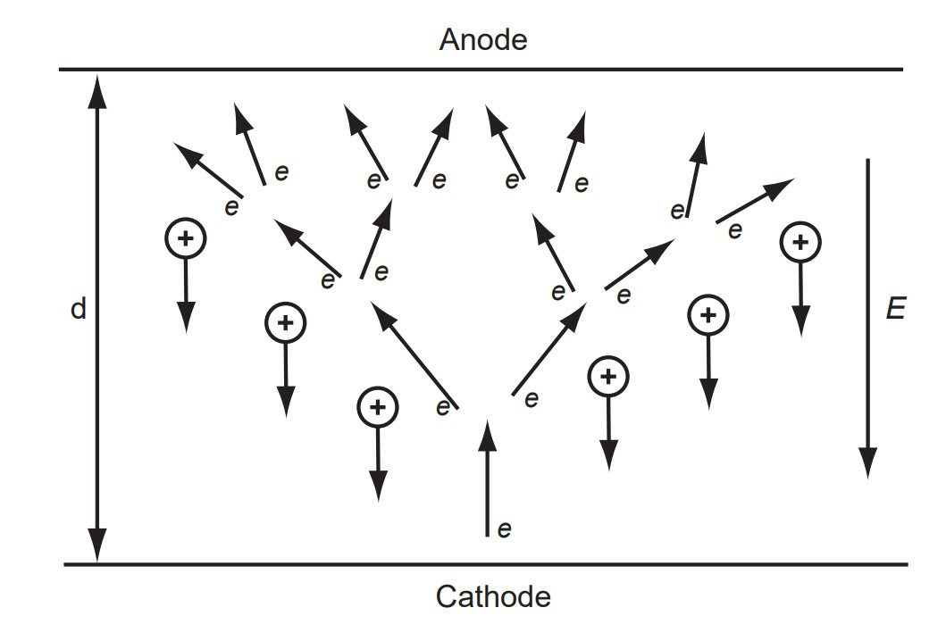
Detectors for gamma rays – Energy measurement – Low energy
Since gamma photons of different energies have different interaction cross-sections, different detector types are employed for different energy ranges.
In the low energy range (∼ 0.1 MeV) low-energy photons are absorbed almost immediately due to their high interaction cross section thus resulting in a short mean free path.
Acceleration of primary electrons by electric field
Townsend avalanche
each original ionizing event due to incident radiation produces only one avalanche
Gas-filled detectors - ability to fine-tune the effective thickness of the detection region by adjusting gas pressure
Proportional counter – gas multiplication

Slide 7
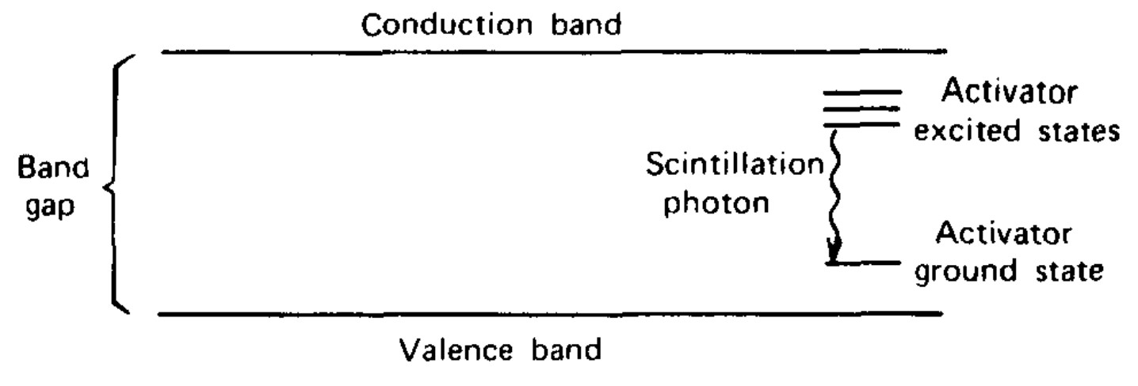
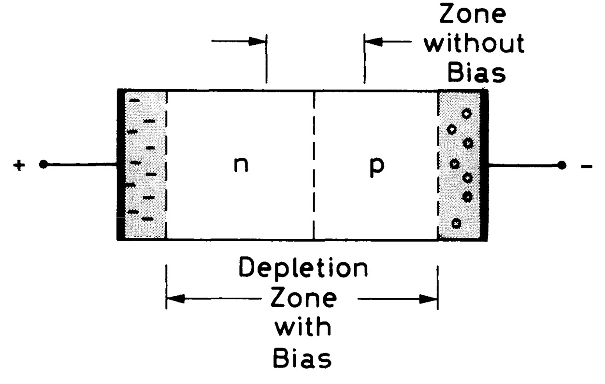
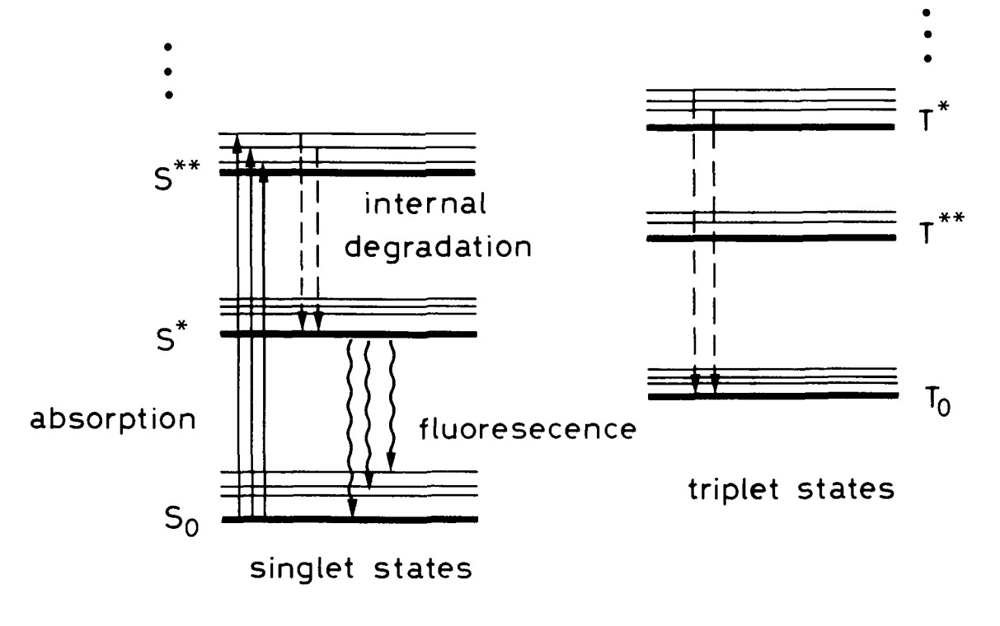
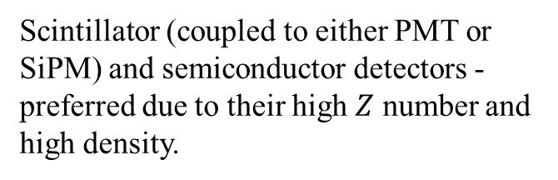
Detectors for gamma rays – Energy measurement – Mid energy
In the mid-energy range (0.1 - 10 MeV), the process that dominates is Compton scattering. Usually the gamma photon has enough energy to undergo multiple Compton scatterings until it finally gets absorbed in the medium.
Scintillator (coupled to either PMT or SiPM) and semiconductor detectors - preferred due to their high $Z$ number and high density.
Depletion zone – detector active volume
Smaller band gap
Scintillator detectors – inorganic (above) , organic (below)
Better energy resolution

Slide 8
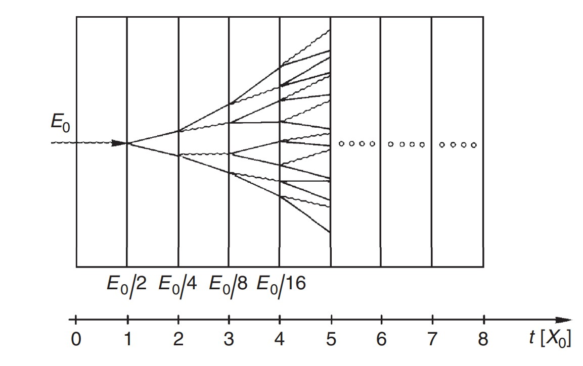
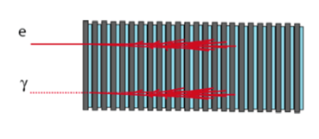
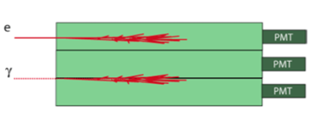
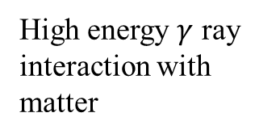
Detectors for gamma rays – Energy measurement – High energy
For gamma photons with energies exceeding 10 MeV, pair production becomes the dominant interaction mechanism. In this energy range, electromagnetic calorimeters are essential for accurately measuring the energy deposited by electromagnetic showers.
two types of calorimeters - sampling and homogeneous
Sampling calorimeter
Homogeneous calorimeter
High energy $γ$ ray interaction with matter
electron and positron pair
cascade of photons, electrons and positrons
bremsstrahlung photons

Slide 9
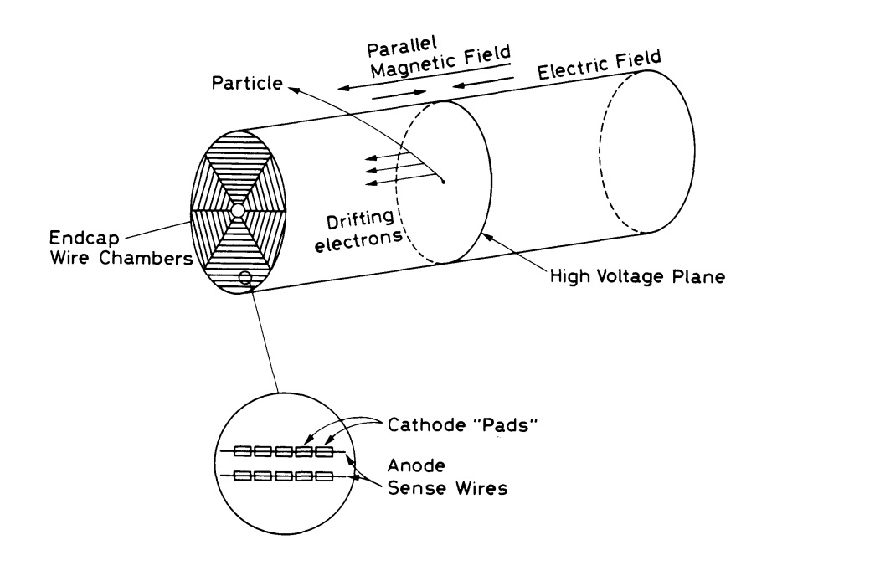
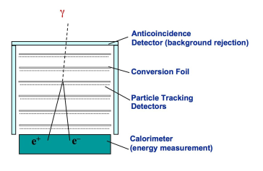
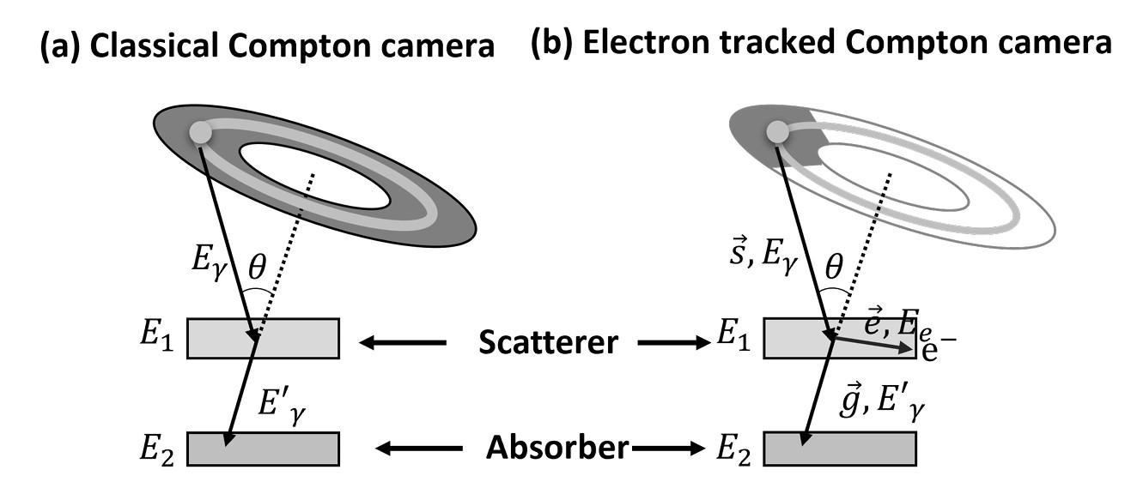
Detectors for gamma rays – Direction measurement
TPC tracking
Tracking of electron positron pairs
Tracking of the scattered Compton electron
Tracking of the recoil electron helps constrain the Compton circle to a point.
Electrons drift to the readout plane, where anode wires and segmented cathode strips determine the interaction point.
Tracking through high $Z$ converter tracker

Slide 10
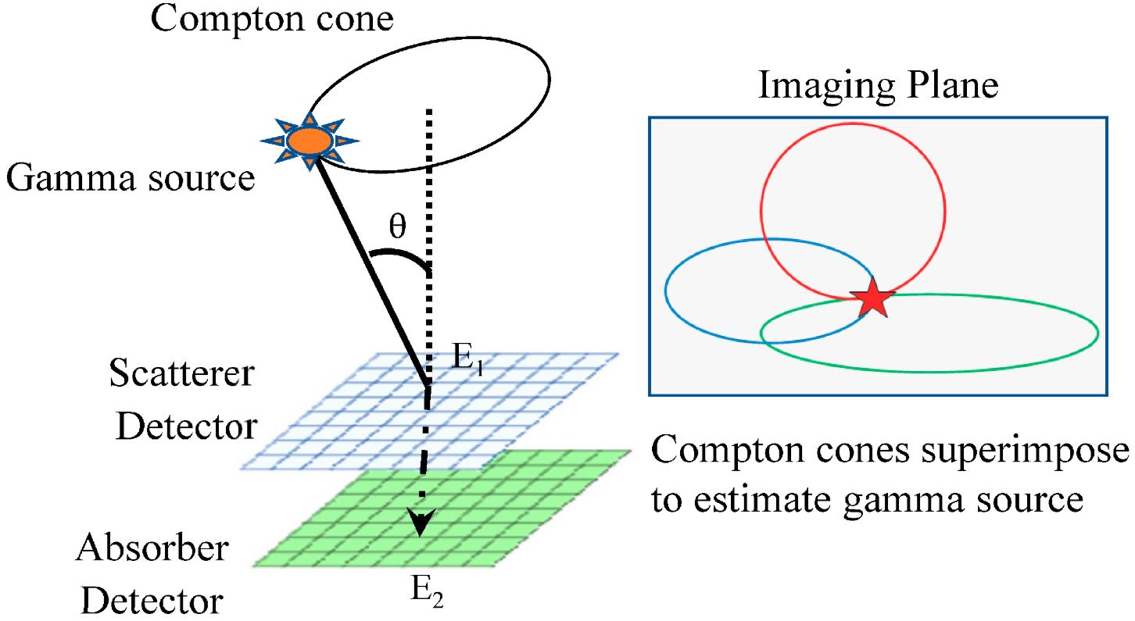


Basic principles of Compton camera
Compton camera - gamma-ray detection system that utilizes the kinematic principles of Compton scattering to reconstruct the incoming photon’s trajectory.
By measuring the energy and interaction positions of scattered gamma rays within the detectors it is possible to infer the direction of the incident photon.
Back projection method:
A basic Compton camera consists of two subdetectors: a scatterer and an absorber.
Region with the highest cone density
Most probable location of the source

Slide 11
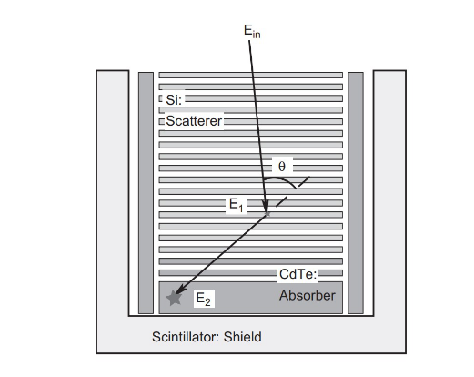
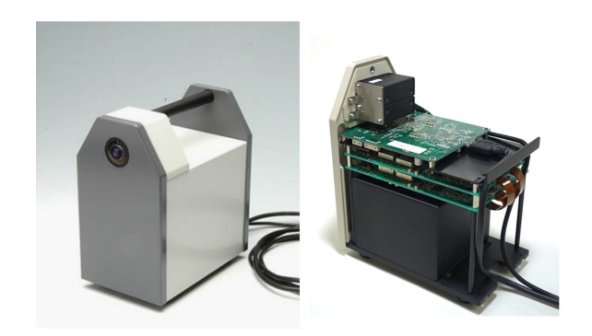

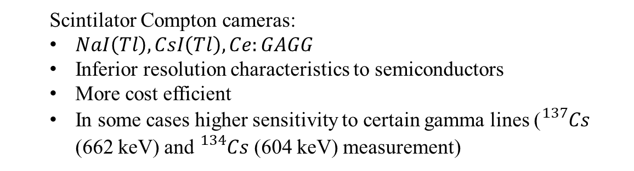
Basic principles of Compton camera – Design types
Si/CdTe based Compton camera
  $Ce:GAGG$ based Compton camera
GAGG - gadolinium aluminum gallium garnet
  Semiconductor Compton cameras:
  Use Si/CdTe or Ge
  High energy resolution
  Cryogenic cooling needed for Ge
  strip detectors – 3D interaction positions
  Scintilator Compton cameras:
  $NaI\left(Tl\right), CsI\left(Tl\right), Ce:GAGG$
  Inferior resolution characteristics to semiconductors
  More cost efficient
  In some cases higher sensitivity to certain gamma lines (${}_{}^{137}{Cs}$ (662 keV) and ${}_{}^{134}{Cs}$ (604 keV) measurement)

Slide 12
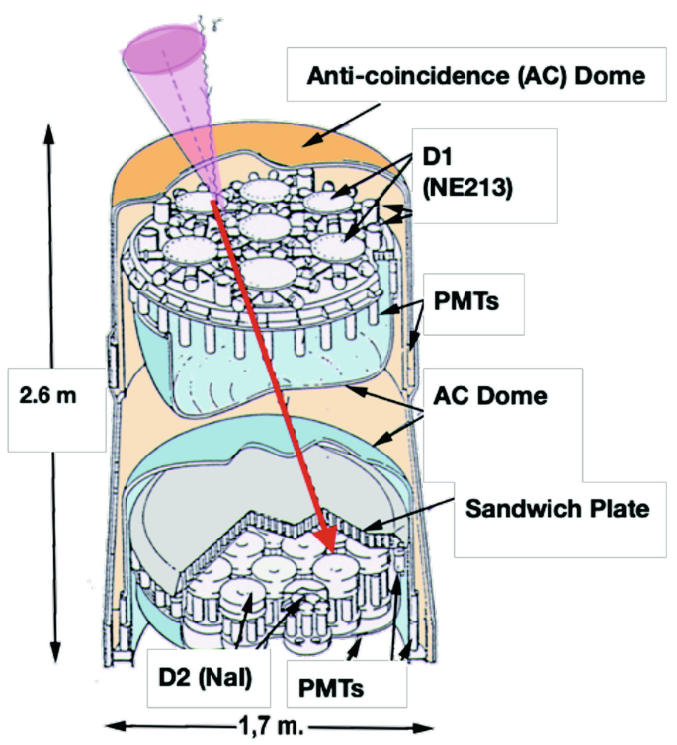
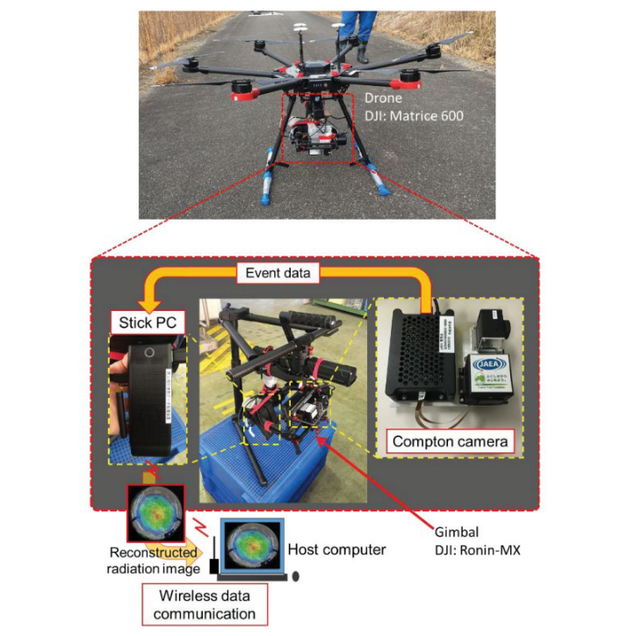
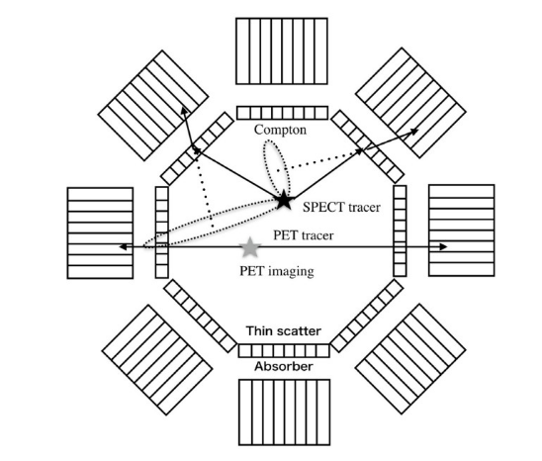
Basic principles of Compton camera – Applications
Medical applications
Space applications
Environmental monitoring application
PET–Compton hybrid imager consisting of thin and thick energy-resolving detectors
Probing cosmic phenomena – COMPTEL (1-10 MeV)
Compton camera + drone

Slide 13
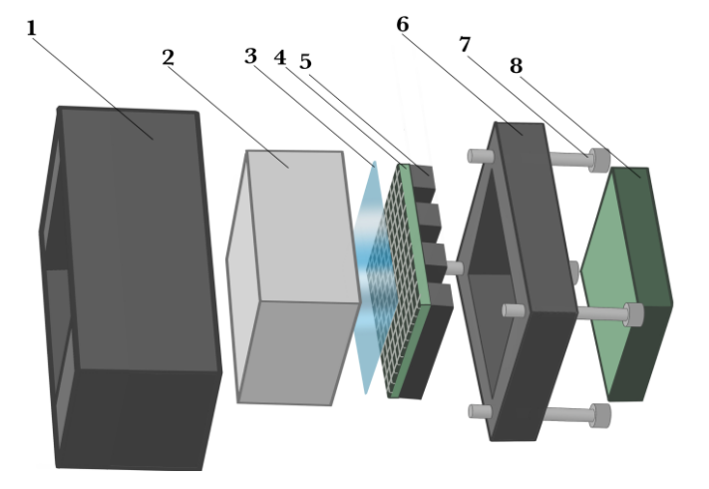
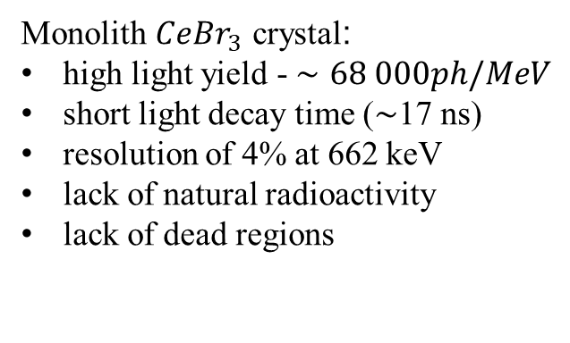
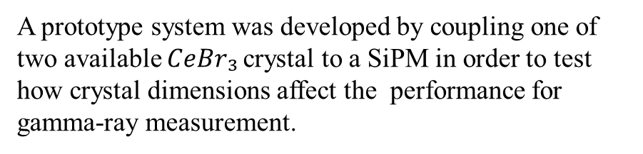


Study of prototypes towards the construction of a Compton camera
- Design
A prototype system was developed by coupling one of two available $CeBr₃$crystal to a SiPM in order to test how crystal dimensions affect the performance for gamma-ray measurement.
Monolith $CeBr_{3}$ crystal:
high light yield - $∼68 000ph/MeV$
short light decay time (∼17 ns)
resolution of 4% at 662 keV
lack of natural radioactivity
lack of dead regions
A schematic schematic representation of the SiPM+Crystal setup
Thick crystal - $51 × 51 × 25 mm^{3}$
Thin crystal - $51 × 51 ×10 mm^{3}$

Slide 14
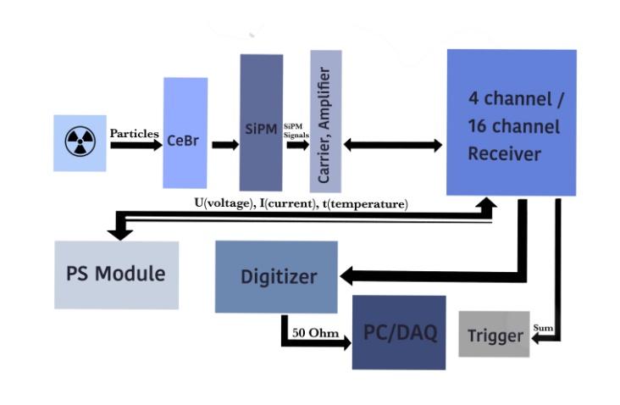
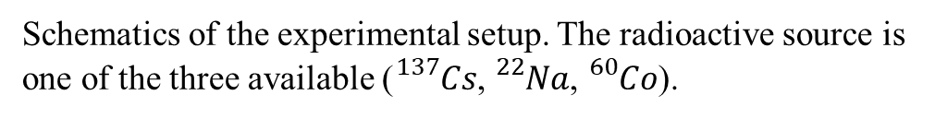
Study of prototypes towards the construction of a Compton camera
- Readout
Schematics of the experimental setup. The radioactive source is one of the three available (${}_{}^{137}{Cs}$, ${}_{}^{22}{Na}$, ${}_{}^{60}{Co}$).

Slide 15
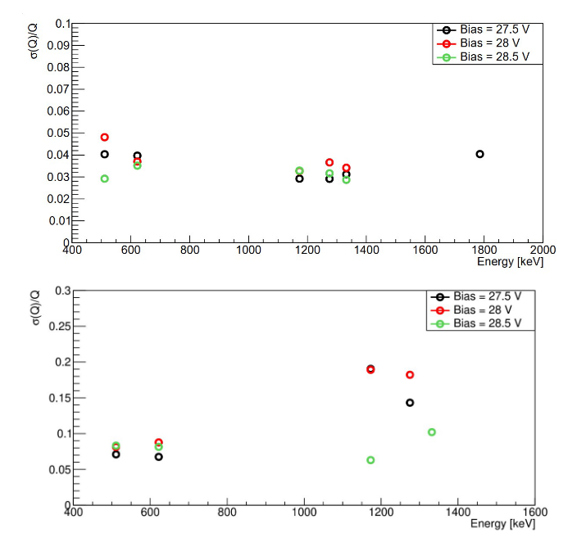


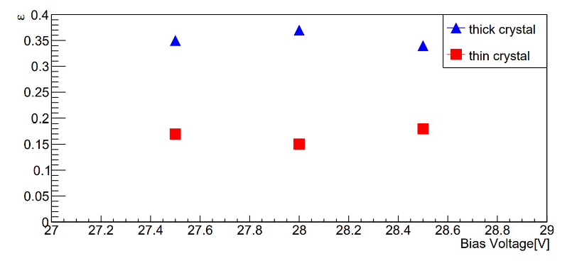

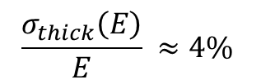
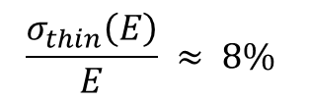

Study of prototypes towards the construction of a Compton camera
- Results
Energy resolution
Efficiency
$$\frac{σ_{thick}\left(E\right)}{E} ≈4\%$$
$$\frac{σ_{thin}\left(E\right)}{E} ≈ 8\%$$
$$ε_{thick} ≈ 0.35$$
$$ε_{thin} ≈ 0.15$$

Slide 16
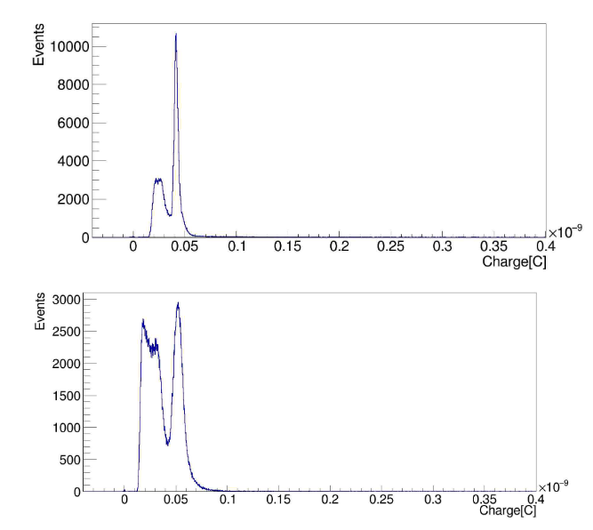
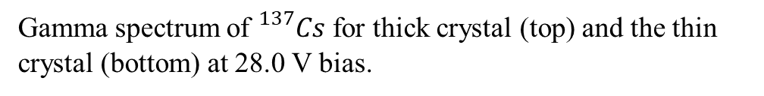
Study of prototypes towards the construction of a Compton camera
- Results
The Compton edge is more pronounced in the spectrum from the thin crystal , due to Compton-scattered photons escaping the scintillator without undergoing further interactions, which results in a higher deposited energy corresponding to a photon scattering angle of 180°
Gamma spectrum of ${}_{}^{137}{Cs}$ for thick crystal (top) and the thin crystal (bottom) at 28.0 V bias.

Slide 17
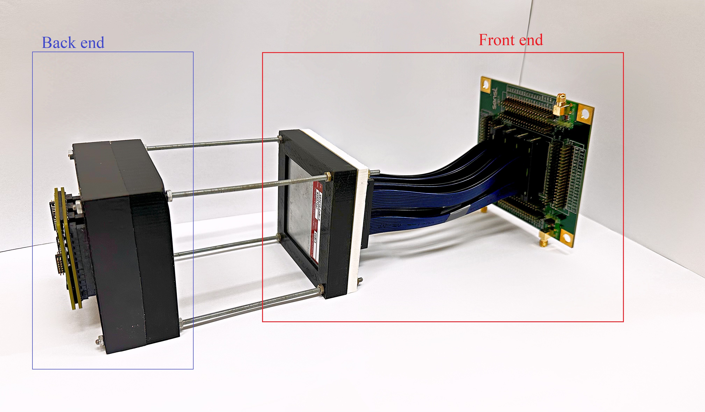
Conclusions
Understanding gamma photon interactions within different media guides detector designs in a way that ensures the right choice of material and instrumentation for each energy range and application.
In our case specifically
Choice of scintillator thickness plays a crucial role in determining overall performance of the Compton camera
Next step - integration of the studied scintillator crystals into a full Compton camera

Slide 18
Results dissemination
Conferences and Papers:
Asova, V., Bistrev, G., Buchakchiev, V., & Kozhuharov, V. (2023). Multichannel SiPM test readout system for gamma ray measurements with monolithic inorganic CeBr₃. Journal of Physics: Conference Series, 2668(1), 012002. https://doi.org/10.1088/1742-6596/2668/1/012002
- Presentation at the Fourth National Forum on Contemporary Space Research (2024) (NaFSKI IV)
Asova, V., Bistrev, G., Kushleva, A., Lalkovski, S., & Vasilev, I. (2023). Multichannel SiPM test readout system for gamma ray measurements. Journal of Physics: Conference Series, 2668(1), 012002. https://doi.org/10.1088/1742-6596/2668/1/012002
- Presentation at the Third National Forum on Contemporary Space Research (2022) (NaFSKI III).

