Slide 1

Sofia University "St. Kliment Ohridski"
Faculty of Physics
Tree Level Processes in Quantum Electrodynamics with a Dark Sector Extension
Bachelor Thesis Defense
Elina Nestorova
Supervisor: Dr. Momchil Naydenov, Chief Assistant Professor
Sofia 2026

Slide 2
Contents
01
Introduction & Motivation
02
Theoretical Foundations
03
Scattering Amplitude & Cross Section
04
Extension to a Dark Sector
05
Conclusion
Notes:
Overview of the five parts of the talk.

Slide 3
Introduction & Motivation
01
1
Notes:
Section divider.

Slide 4
QED and Tree-Level Scattering
Quantum electrodynamics is the theory that describes how electrons, positrons, and photons interact. All interactions come from the Lagrangian, and from it we derive a set of computation rules — Feynman rules — that let us calculate the probability of any given process.
Tree-level diagrams are the lowest-order term in the perturbative expansion — the first, and most direct, prediction the theory makes for a scattering process
Møller scattering, e⁻e⁻ → e⁻e⁻, is a textbook QED process: historically central to testing the theory, and still used today for detector calibration and luminosity measurements at colliders
Notes:
Set up QED and why tree-level diagrams matter.

Slide 5
Motivation: Searches for a Dark Photon
Over the last couple of decades there's been growing interest in the idea that there might be particles that don't interact through the known forces, except very weakly. One of the simplest and most studied candidates is the dark photon.
A dark photon A′ is a hypothetical massive vector boson coupling to electrons through kinetic mixing with the ordinary photon: the effective coupling is e_A = εe
Because Møller and Bhabha scattering both go through exactly the same electron-photon vertex, they are natural, sensitive channels to search for this coupling.
The PADME experiment (Laboratori Nazionali di Frascati) searches for dark photons via e⁺e⁻ → γA′, and needs precise control of Standard-Model backgrounds — annihilation, bremsstrahlung, and Bhabha/Møller scattering
This thesis derives tree-level Møller scattering in ordinary QED, then replace the photon by a massive dark-photon mediator and study the effect on the cross section
Notes:
Motivate the second half of the thesis: why extend Moller scattering with a dark photon, and PADME context.

Slide 6
Theoretical Foundations
02
2
Notes:
Section divider.

Slide 7
From Maxwell's Equations to the QED Lagrangian
Classical to quantum
Gauge symmetry
Maxwell's equations can be derived from L_EM = −¼F_μνF^μν − J_μA^μ. (free electromagnetic field term and a term coupling the field to a current)
To get to quantum electrodynamics, I promote that classical current to a quantum operator built from the electron's Dirac field J^μ → ψ̄γ^μψ (ψ describes the electron quantum mech.) and adding the free Dirac Lagrangian for the electron field gives the full QED Lagrangian.
There's a reason this interaction term has exactly the form it does, and that's gauge symmetry
If you require the theory to stay invariant under a local U(1) phase rotation of the electron field ψ → e^iα(x)ψ, you are forced to introduce exactly the photon field, transforming in this way.
L_QED = ψ̄(iγ^μ∂_μ − m)ψ − ¼F_μνF^μν + eψ̄γ^μψA_μ
A_μ → A_μ − (1/e)∂_μα(x)
Notes:
Compress sections 2 into one slide: Lagrangian construction and gauge symmetry.

Slide 8
Feynman Rules and the S-Matrix Expansion
ELEMENT
RULE
Electron–photon vertex
(−ie)γ^μ
Internal photon propagator
−ig^μν / q²
Internal electron propagator
i(p̸ + m) / (p² − m² + iε)
External electron line
spinor u(p) or ū(p)
External photon line
polarization vector ε^μ(k)
From that Lagrangian, quantization gives us a small set of computation rules that let us translate any diagram directly into a mathematical expression. These rules come from expanding the S-matrix — the operator that connects an initial state to a final state .
Notes:
Sections 3 and 4: S-matrix expansion and the Feynman rule table.

Slide 9
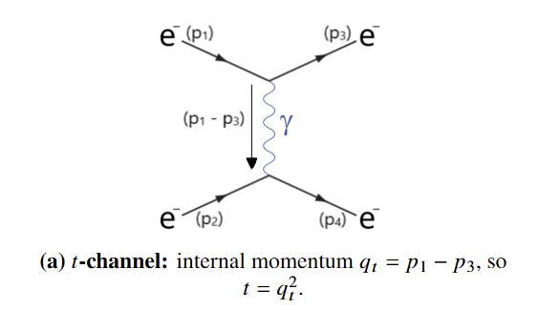
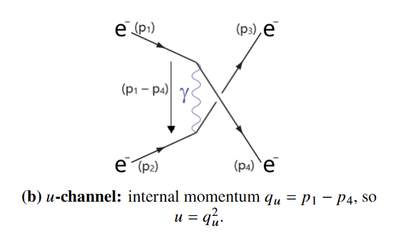
Møller Scattering: Tree-Level Diagrams
Because these two diagrams both end in the same final state, and the electrons are indistinguishable fermions, quantum mechanics requires that I subtract them, not just add them. The total amplitude is M = M_t - M_u. That minus sign is the mathematical fingerprint of Fermi-Dirac statistics — of the Pauli exclusion principle, essentially — for identical fermions.'
Notes:
Show the t and u channel diagrams and explain the antisymmetrization.

Slide 10
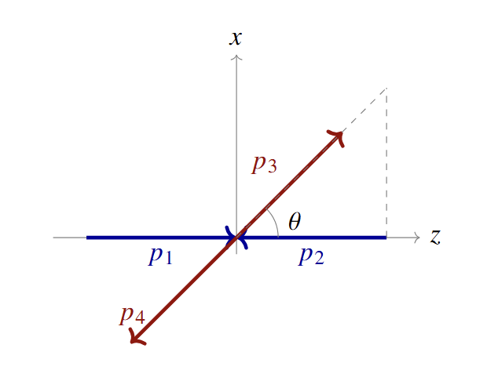
Kinematics in the Center-of-Mass Frame
Our energy point
To get numbers, I need to fix a reference frame and specific energies.
Each incoming electron carries E = 0.55 GeV, so the total center-of-mass energy is √s = 2E = 1.10 GeV — small enough that the electron mass is negligible (ultrarelativistic limit).
s = 4E² t = −4E²sin²(θ/2) u = −4E²cos²(θ/2)
θ is the angle between the incoming electron p₁ and the outgoing electron p₃ — the quantity a detector actually measures.
Notes:
Section 5: CoM frame setup, beam energy, Mandelstam variables.

Slide 11
Scattering Amplitude & Cross Section
03
3
Notes:
Section divider.

Slide 12
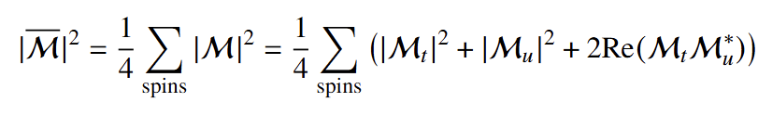
Spin-Averaged Squared Amplitude
What we actually measure in an experiment isn't the amplitude M itself, but its absolute value squared, averaged over the spins of the incoming particles
The factor ¼ averages over the 2×2 spin states of the two incoming electrons
Pure t-channel term, ∝ |AB|² / t² — direct photon exchange
Pure u-channel term, ∝ |CD|² / u² — exchange photon diagram
Interference term, ∝ Re(AB(CD)*) / (tu) — essential precisely because the final-state electrons are indistinguishable
Notes:
Section 6 intro: structure of the spin-averaged squared amplitude.

Slide 13
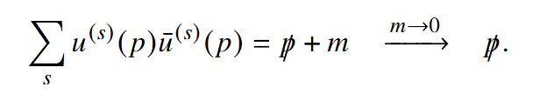
Trace Technology for Gamma Matrices
To evaluate the spin sums we use trace technology.
The completeness relation Σ_s u^(s)(p)ū^(s)(p) = p̸ + m (→ p̸ in the massless limit) turns spinor bilinears into traces of gamma matrices
Standard trace identities: Tr[γ^μγ^ν] = 4g^μν; Tr[γ^μγ^νγ^ργ^σ] = 4(g^μνg^ρσ − g^μρg^νσ + g^μσg^νρ);the trace of two gamma matrices gives the metric tensor; the trace of four gamma matrices gives this particular combination of metric tensors; and the trace of any odd number of gamma matrices is simply zero.
Applying these identities mechanically reduces everything down to ordinary dot products of the four-momenta, which I then rewrite in terms of the Mandelstam variables, s, t and u.
Notes:
Section 6.1-6.2: completeness relation and trace identities.

Slide 14
Squared Amplitude in Mandelstam Variables
Spin sums
Complete squared amplitude
T = Σ|AB|² = 8(s² + u²)
|M̄|² = 2e⁴ [ (s²+u²)/t² + (s²+t²)/u² + 2s²/(tu) ]
U = Σ|CD|² = 8(s² + t²)
Substituting the center-of-mass kinematics makes the singular forward (θ→0) and backward (θ→π) behavior explicit.
I = 2Σ Re(AB(CD)*) = 16s²
Notes:
Section 6.3: final results for T, U, I and the compact squared amplitude.

Slide 15
Differential Cross Section: Analytic Result
General 2→2 relation: dσ/dΩ = |M̄|² / (128π²s)
In the high-energy limit, s = 4E², t = −2E²(1−z), u = −2E²(1+z), with z ≡ cos θ
This one line is the fully analytic prediction of tree-level QED for the angular distribution of Møller scattering.
Substituting the high-energy kinematics, with z defined as cosine theta, and simplifying (in Mathematica) everything collapses into this remarkably compact closed form:
dσ/d cos θ = (πα² / s) · (3+z²)² / (1−z²)²
where α = e²/4π is the fine-structure constant. The expression diverges sharply as z → ±1 — the characteristic signature of a massless photon propagator.
Notes:
Sections 7-8: derive dsigma/dcostheta and the compact result.

Slide 16
Numerical Cross-Check: CalcHEP Workflow
Enter Process: specify e, e → e, e — Møller scattering (widely-used particle physics event generator.)
CalcHEP auto-generates the tree-level diagrams: the same t-channel and u-channel photon exchanges, required by the antisymmetry of identical fermions
Make and Launch opens the numerical module; both incoming electrons are assigned E₁ = E₂ = 0.55 GeV, i.e. √s = 1.10 GeV
1D Integration → Angular Dependence, evaluated on a grid of 100 points in cos θ
Output: the numerical differential cross section dσ/d cos θ across the full angular range
Notes:
Describe the CalcHEP steps used to validate the analytic result.

Slide 17
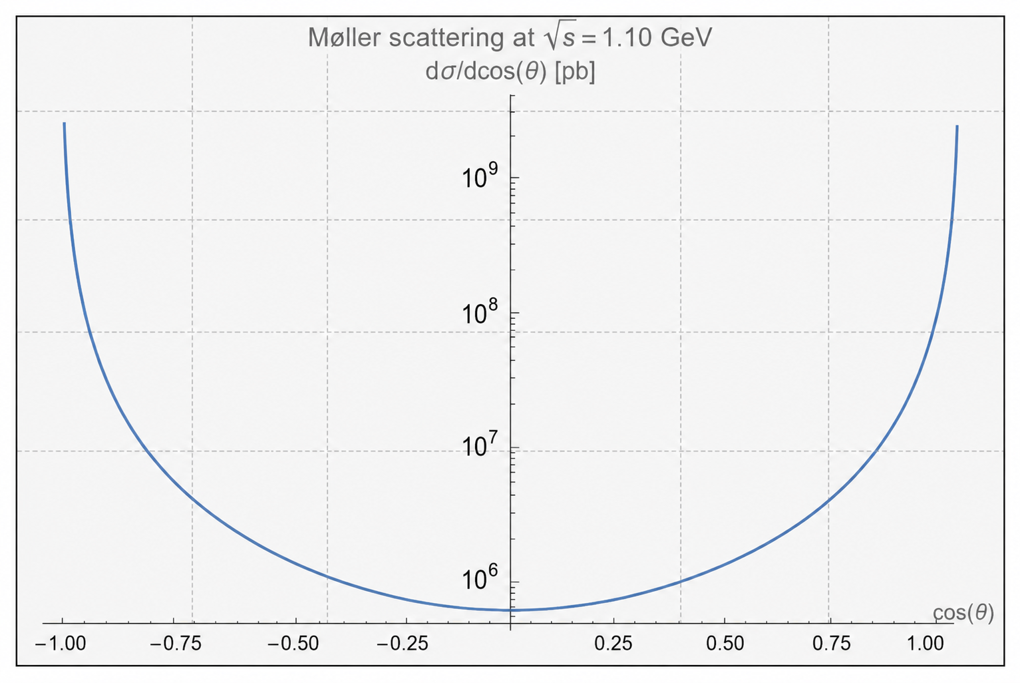
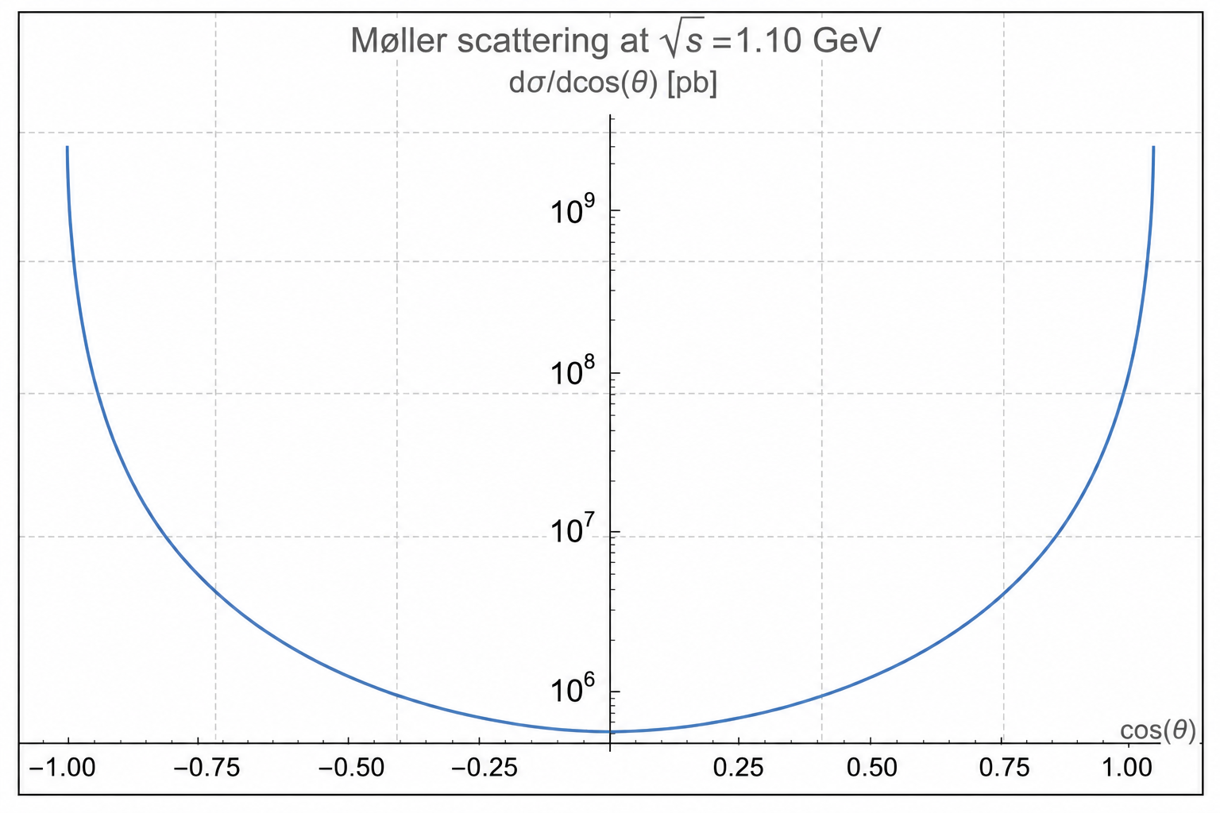
Comparison: Analytic Result vs. CalcHEP
The Mathematica-plotted analytic formula (right) and the CalcHEP 100-point numerical grid (left) coincide exactly. Both show the same sharp forward (z→1) and backward (z→−1) enhancement, confirming the trace-based derivation against the automated computation.
Notes:
Show Figure 2 recreated as an accurate chart: analytic curve vs CalcHEP grid points, log y-axis.

Slide 18
Physical Interpretation of the Angular Distribution
Forward scattering (θ→0, z→1): electrons barely deflected — dominated by the t-channel, 1/t² singularity
Backward scattering (θ→π, z→−1): strong exchange effect from electron indistinguishability — dominated by the u-channel, 1/u² singularity
The interference term matters only because the two final electrons cannot be told apart
These divergences are universal to massless-mediator exchange — regulated only by a finite mediator mass, exactly the effect the dark photon will introduce
Notes:
Interpret the divergences physically before moving to the dark photon extension.

Slide 19
Extension to a Dark Sector
04
04
04
Notes:
Section divider.

Slide 20
The Dark-Photon Model
MODEL ELEMENT
DEFINITION
MEANING
Coupling
ee1 = 0.000303
rescaled coupling e_A = εe, ≈10⁻³ of the electric charge
Mediator
vector A1: mass M_A = 0.017 GeV
the dark photon, a new massive gauge boson
Matter field
spinor e1: mass m_e = 0.000511 GeV
the physical electron
Interaction
lterm ee1·ē1·γ·A1·e1
vertex e_A ēγ^μeA′_μ, the electron–dark-photon coupling
I built a small particle-physics model using LanHEP(a tool that automatically generates Feynman rules from a Lagrangian), then imported into CalcHEP with exactly the same kinematics as the QED case — same beam energy, same scattering geometry, same Mandelstam definitions — so only the mediator changes.
Notes:
Section 9 intro: the LanHEP model definition and its parameters.

Slide 21
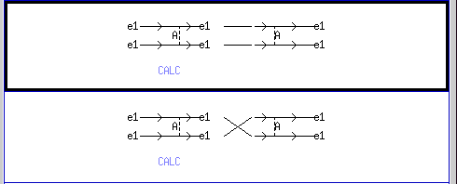
Dark-Photon Møller Diagrams in CalcHEP
CalcHEP builds both diagrams automatically from the single interaction term. As before, the electrons are identical, so both channels interfere.
Notes:
Section 9.1: same topology, mediator replaced by the dark photon.

Slide 22
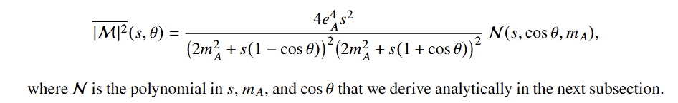
From CalcHEP to the Squared Matrix Element
CalcHEP's Symbolic Calculation exports |M|² in Mathematica-readable form, in terms of scalar products SC[p_i,p_j] and a propagator function propDen
the massless photon propagator, 1 over t, becomes: propDen[−p₁+p₃, m_A, 0] = t − m_A², and 1/t - propDen[−p₁+p₄, m_A, 0] = u − m_A²
Substituting the Mandelstam relations, replacing scalar products in the massless limit, and symmetrizing under t↔u reduces the CalcHEP output to a compact closed form
Notes:
Section 9.2-9.3: symbolic extraction and simplification in Mathematica.

Slide 23
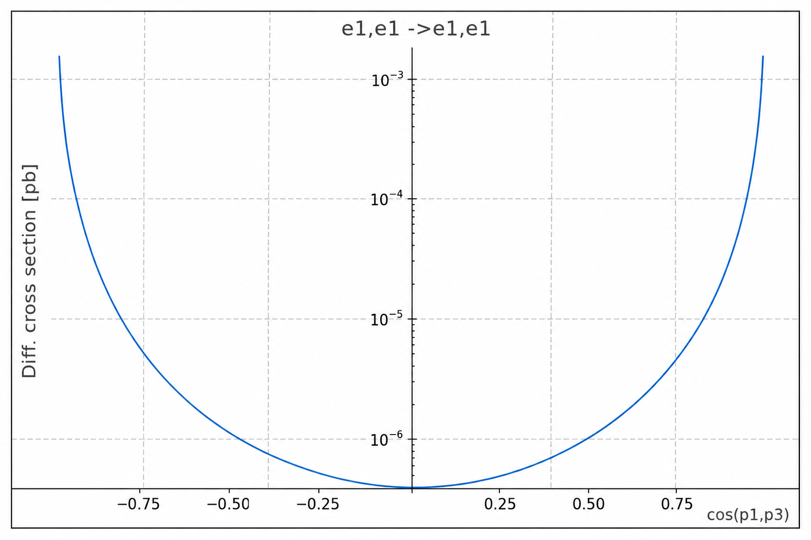
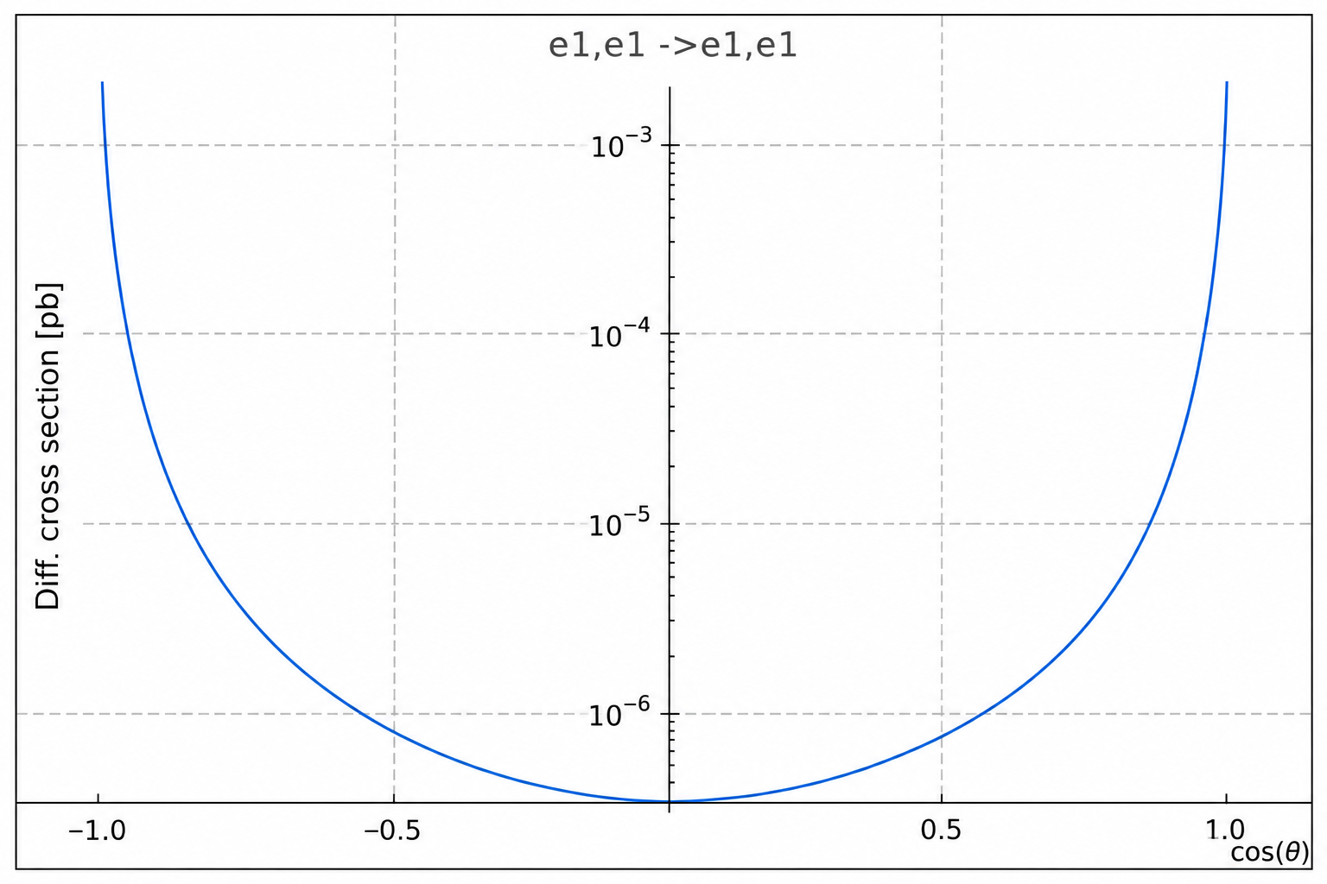
Cross Section for Dark-Photon Exchange
e_A=10⁻⁴, m_A=0.017 GeV
Qualitatively similar to ordinary QED, but the massive propagators (t−m_A², u−m_A²) regulate the forward/backward divergence and the weak coupling suppresses the overall scale by roughly 13 orders of magnitude relative to QED.
Notes:
Section 9.3 continued: final cross-section formula, single-curve plot with realistic parameters.

Slide 24
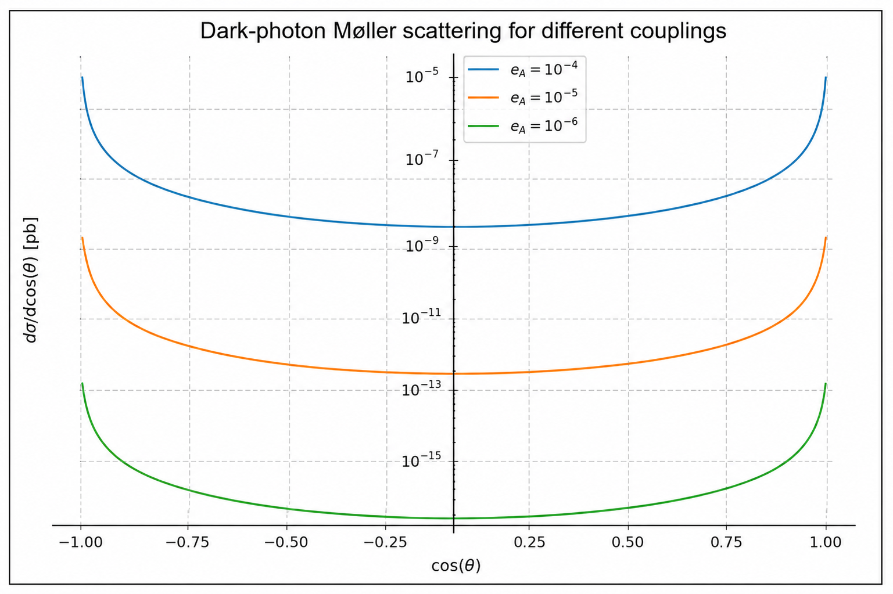
Dependence on the Coupling Constant
Keeping the mediator mass fixed at 0.017 GeV, and scanning e_A over three values. The three curves share an identical angular shape — the kinematics and propagator structure are unchanged — but differ only in overall normalization, exactly as expected from dσ/d cos θ ∝ e_A⁴: Each time I drop the coupling by one order of magnitude, the entire curve drops by four orders of magnitude
Notes:
Section 9.4: three curves for eA, fixed mass, log-y, discuss scaling as eA^4.

Slide 25
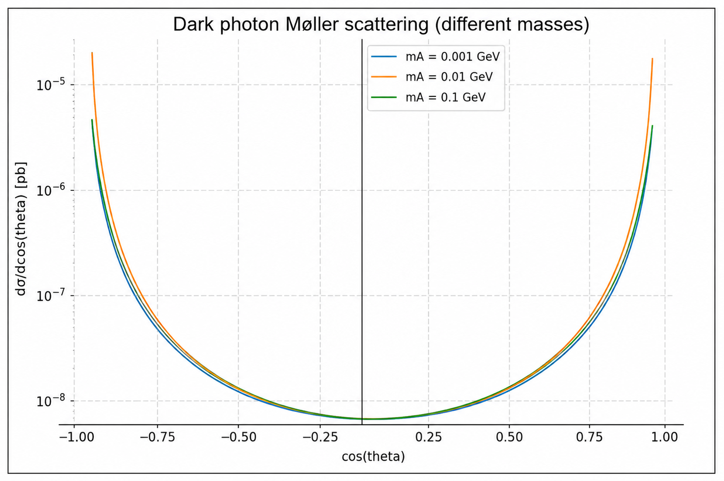
Dependence on the Mediator Mass
I did the reverse scan: fixed the coupling at 10 to the minus 4, and varied the dark-photon mass instead, over 0.001, 0.01, and 0.1 GeV. Unlike the coupling constant, the mediator mass doesn't just rescale the curve — it actually reshapes the angular distribution, regulating the forward and backward divergence.
Notes:
Section 9.5: three curves for mA, fixed coupling, log-y, discuss shape change and small-mass overlap.

Slide 26
Conclusion
05
05
05
05
Notes:
Section divider.

Slide 27
Summary of Results
Derived the tree-level Møller-scattering amplitude and spin-averaged squared matrix element from first principles, using trace technology and Mandelstam variables
Obtained the analytic cross section dσ/d cos θ = (πα²/s)(3+z²)²/(1−z²)², independently confirmed by a CalcHEP numerical calculation
Extended the model with a massive dark photon (LanHEP + CalcHEP + Mathematica), deriving the corresponding differential cross section
Showed that the dark-photon coupling controls the overall magnitude (∝e_A⁴), while its mass controls the shape — regulating the forward/backward divergence characteristic of massless-mediator exchange
Notes:
Section 10 first half: recap the main results.

Slide 28
Why this hypothetical particle is called a dark photon if it possesses a non-zero mass?
Photon' refers to its role as a U(1) gauge boson, not to being massless — just like the W and Z bosons are massive gauge bosons of the electroweak symmetry. The dark photon gets its mass the same general way, through symmetry breaking in the dark sector. 'Dark' separately just means it couples very weakly to ordinary matter, through kinetic mixing.
Notes:
Section 10 second half: connect back to PADME and future work.

Slide 29
When considering electron on positron (e +e − → e +e −) scattering, will the tree-level contributions to the processes be identical to those in electron on electron (e −e − → e −e −) scattering?
Both processes have two tree-level diagrams, and both share the same t-channel photon-exchange diagram. But the second diagram is different:
Møller (e⁻e⁻→e⁻e⁻): the second diagram is a u-channel exchange — swapping the two outgoing electrons, since they're identical particles.
Bhabha (e⁺e⁻→e⁺e⁻): the second diagram is an s-channel annihilation — the electron and positron annihilate into a virtual photon, which then produces the outgoing e⁺e⁻ pair.
This annihilation channel is only possible because the electron and positron have opposite charge (net charge zero, so they can annihilate into a neutral photon). Two electrons have the same charge, so they can never annihilate into a single photon — that's why Møller scattering has no s-channel diagram at all.
So the two processes are related (the shared t-channel piece maps between them via crossing symmetry, s↔u), but they are not identical — the second diagram has a completely different physical origin in each case.
Notes:
Section 10 second half: connect back to PADME and future work.

Slide 30
What is the underlying physical motivation for choosing an incoming electron energy of 550 MeV and a dark photon mass of 17 MeV?
The values aren't arbitrary — they're chosen to mirror a real, currently-searched-for experimental scenario:
550 MeV matches the actual positron beam energy used by the PADME experiment at the Laboratori Nazionali di Frascati, the fixed-target experiment mentioned throughout the thesis as the motivating application for this calculation.
17 MeV matches the mass of the proposed X17 boson — the particle suggested by the Atomki anomaly, which PADME has specifically searched for as a possible light dark-photon-like state.
Notes:
Section 10 second half: connect back to PADME and future work.

Slide 31
Thank You
Questions & discussion.
Elina Nestorova
·
Faculty of Physics, Sofia University "St. Kliment Ohridski"
Notes:
Close and invite questions.

